Slide 1
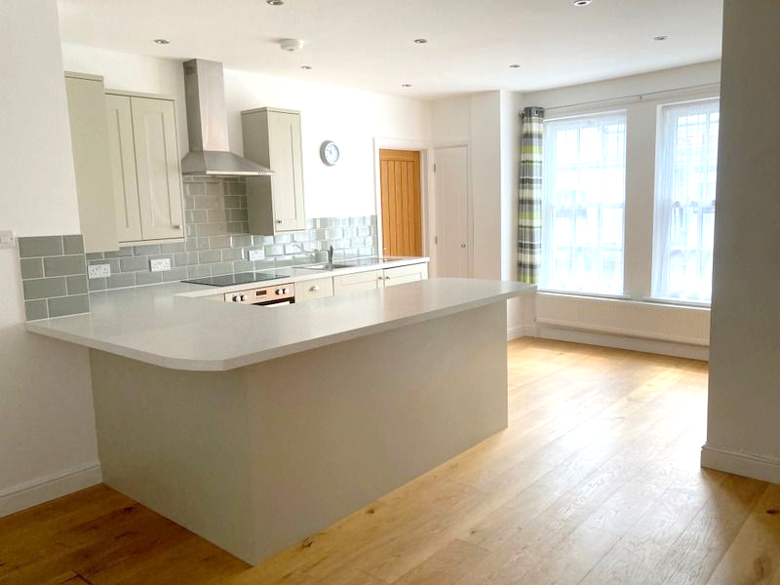
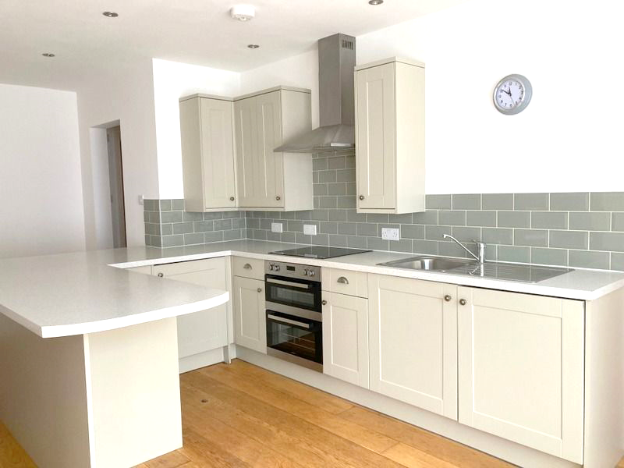
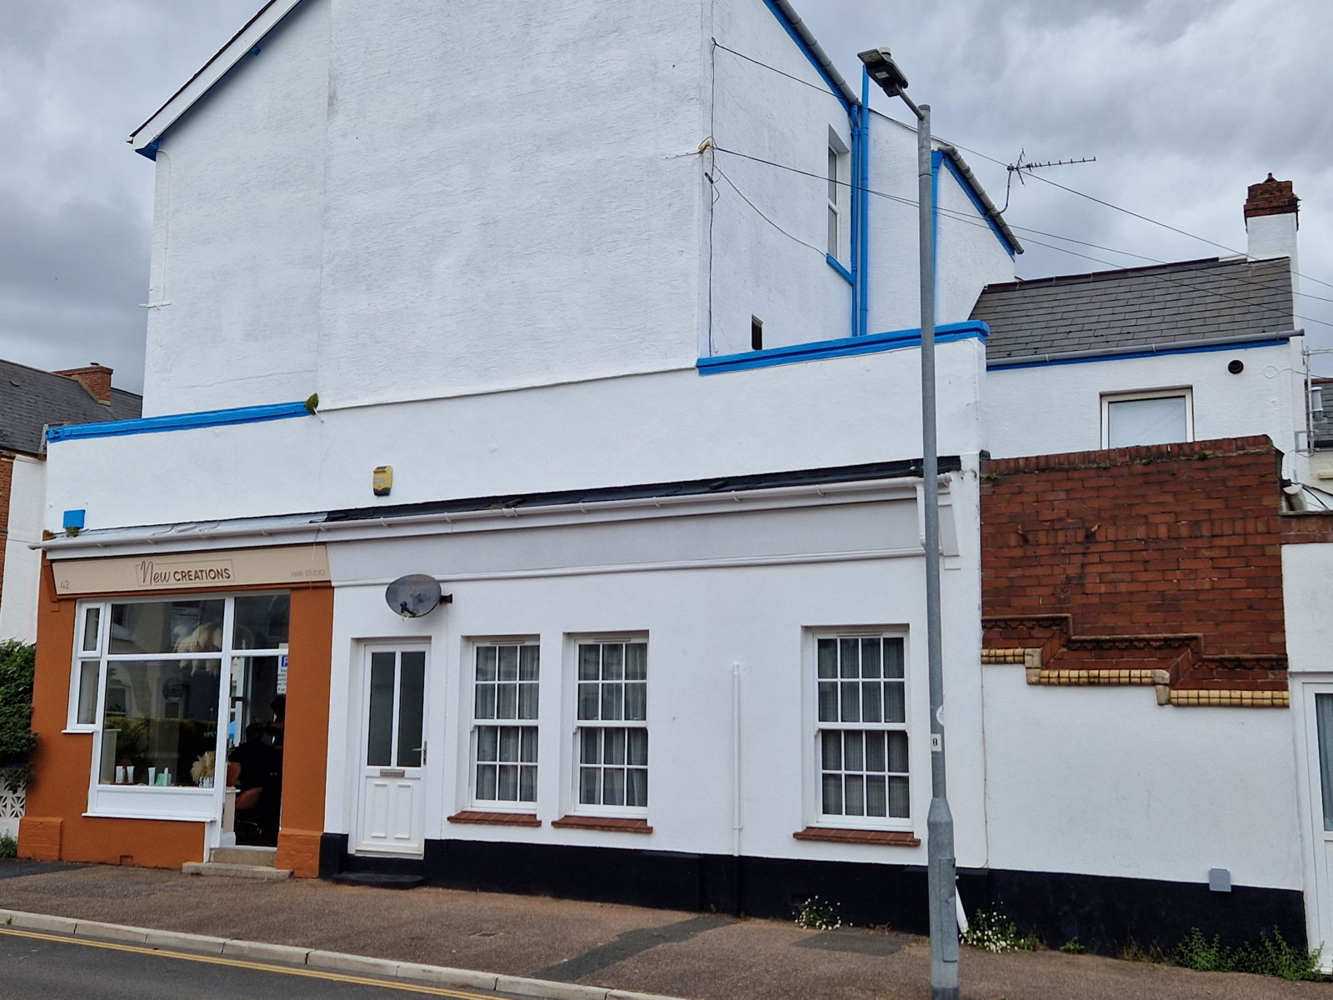
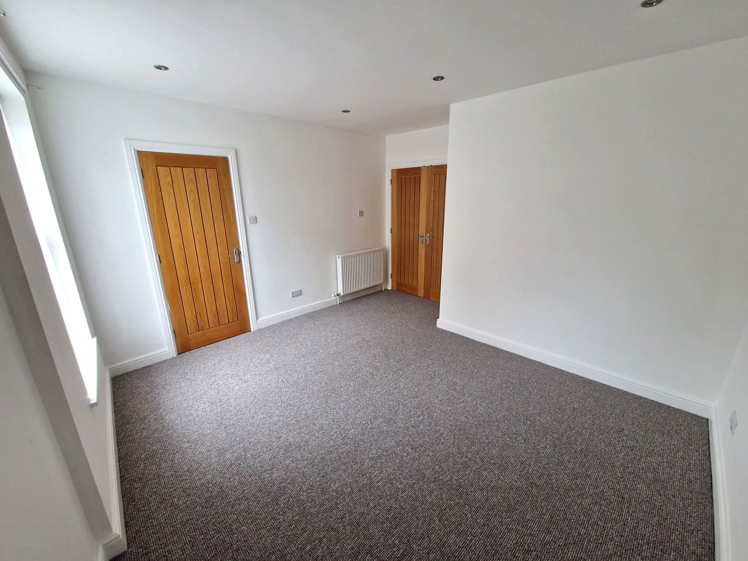
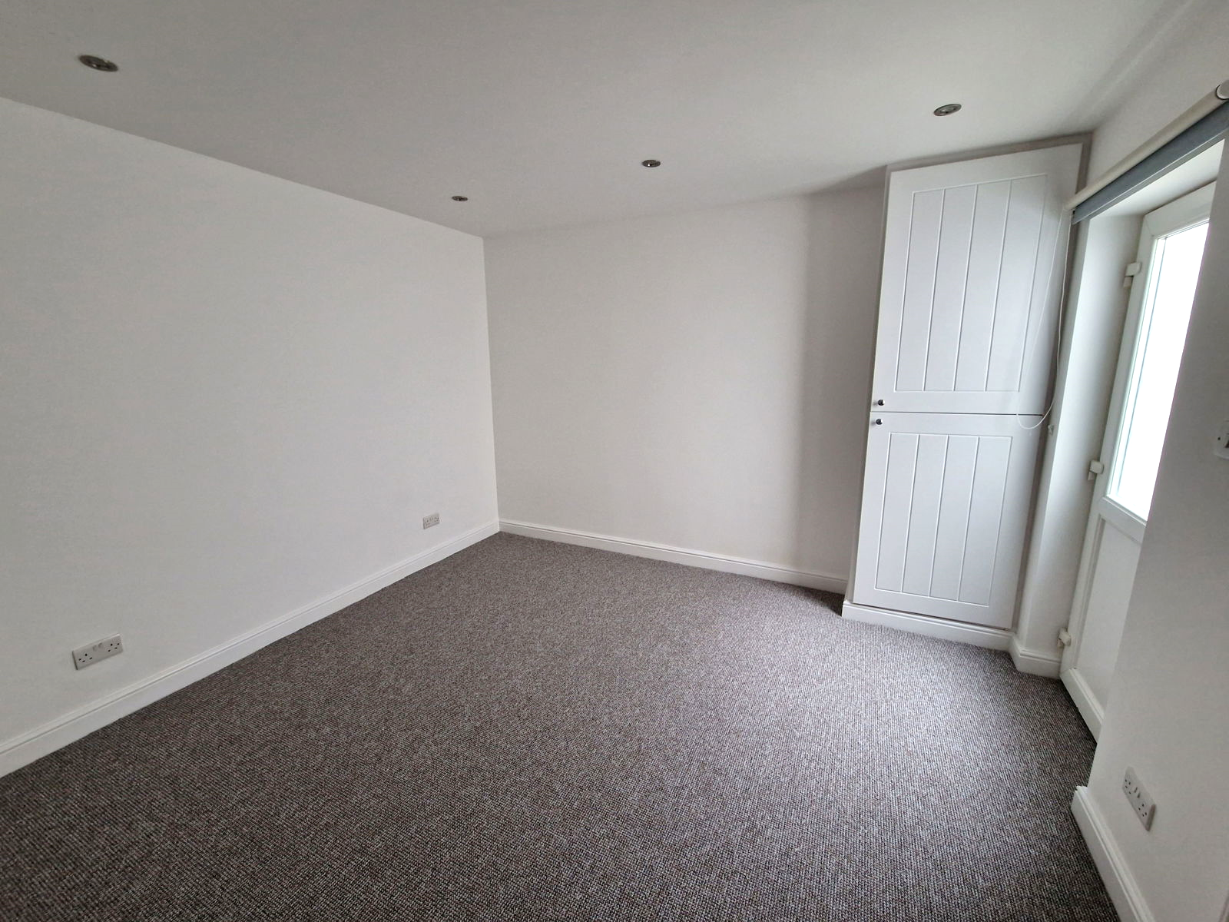
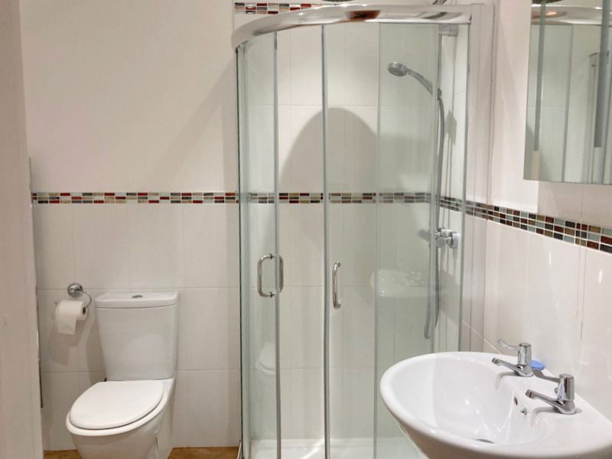
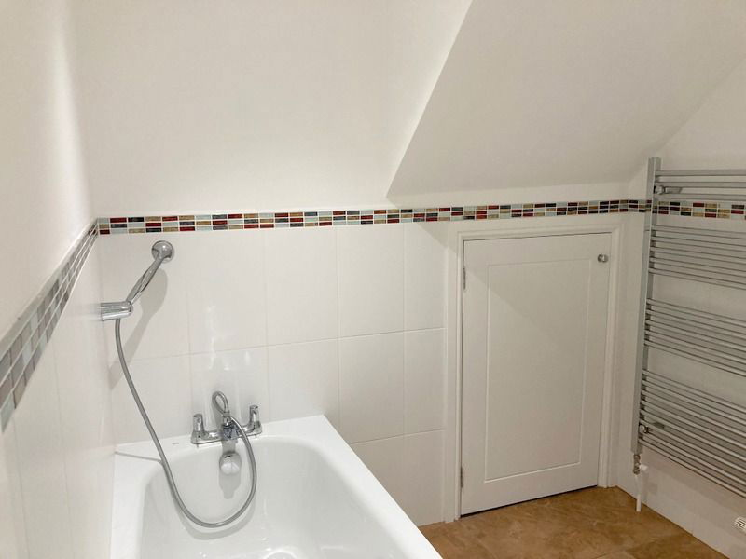
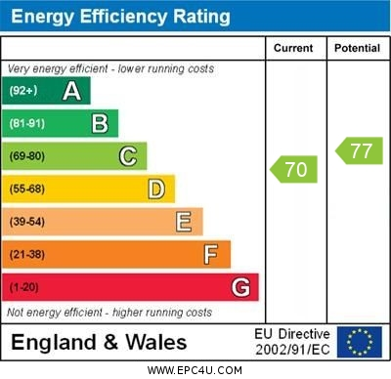
www.pennys.net
42a St. Andrews Road, Exmouth, EX8 1AR
GUIDE PRICE £209,950
TENURE Leasehold
Self-Contained Ground Floor Flat Ideally Located Only A Short Distance From The Seafront And Town Centre
Private Entrance * Spacious Open-Plan Kitchen/Breakfast/Living Room * Two Double Bedrooms * Modern Spacious Bath/Shower Room/Wc * Gas Central Heating * Double Glazed Windows * Super Permanent Or Holiday Home Retreat * Long Lease And Share Of Freehold * Excellent Decorative Order * No Onward Chain
Pennys Estate Agents Limited for themselves and for the vendor of this property whose agents they are give notice that:- (1) These particulars do not constitute any part of an offer or a contract. (2) All statements contained in these particulars are made without responsibility on the part of Pennys Estate Agents Limited. (3) None of the statements contained in these particulars are to be relied upon as a statement or representation of fact. (4) Any intending purchaser must satisfy himself/herself by inspection or otherwise as to the correctness of each of the statements contained in these particulars. (5) The vendor does not make or give and neither do Pennys Estate Agents Limited nor any person in their employment has any authority to make or give any representation or warranty whatever in relation to this property.
PENNYS ESTATE AGENTS
2 Rolle House, Rolle Street, Exmouth, Devon, EX8 2SN
Tel: 01395 264111 EMail: help@pennys.net

Slide 2
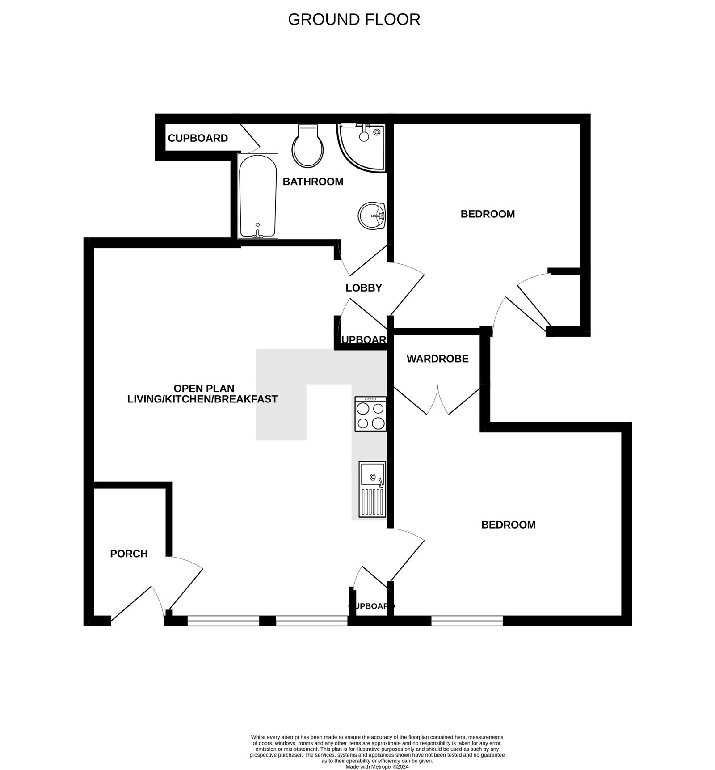
42a St. Andrews Road, Exmouth, EX8 1AR
THE ACCOMMODATION COMPRISES: uPVC double glazed front door to:
ENTRANCE PORCH: With coat rack, radiator, recessed ceiling Led spotlighting, door to:
OPEN-PLAN KITCHEN/BREAKFAST/LIVING ROOM: 6.22m x 5.05m (20'5" x 16'7") maximum overall measurement. A wonderful and most spacious open-plan living space with wooden flooring throughout and recessed Led ceiling spotlighting.
LIVING AREA: Radiator, TV point. Recessed Led ceiling Spotlighting.
KITCHEN/BREAKFAST AREA: Fitted with range of patterned work surfaces extended to provide a breakfast bar area with cupboards, drawer units, integrated fridge and freezer, washer/drying machine beneath worktops, inset single drainer sink unit with mixer tap, inset four ring halogen hob, stainless steel chimney style extractor hood over and built-in electric oven beneath, attractive tiled surrounds, wall mounted cupboards, radiator and two sets of sash style double glazed windows to front aspect, fitted cupboard also housing the gas meter, recessed Led ceiling spotlighting, telephone point in kitchen area. From the Living area there is an opening through to:
BEDROOM 1: 3.96m x 3.91m (13'0" x 12'10") Spacious double bedroom with double glazed sash style window to front aspect, built-in double wardrobe, radiator, recessed ceiling Led spotlighting. Newly fitted carpets.
From the Living area is an opening to:
INNER HALLWAY: With access to shallow cupboard housing electric consumer unit and doors to bedroom two and Bath/Shower room.
BEDROOM 2: 3.58m x 3.3m (11'9" x 10'10") Radiator, cupboard housing gas boiler for hot water and central heating, double glazed door with patterned glass giving access to small decked enclosed courtyard with outside light. Newly fitted Carpets, recessed Led ceiling spotlighting
BATHROOM/WC: 2.59m x 1.98m (8'6" x 6'6") Bath with shower attachment, separate corner shower cubicle with fixed rainfall shower head and detachable shower head hose, pedestal wash hand basin with mirror over with integrated light, WC, attractive and extensively tiled walls, chrome heated towel rail, fitted storage cupboard, tiled flooring, recessed Led ceiling spotlighting.
OUTSIDE: Small enclosed decked courtyard.
TENURE AND OUTGOINGS: Lease: 999 years from 1st January 2015, The property also benefits from 1/3rd of the Freehold of the building. Maintenance: We understand that the owner of the property contributes 25% for any agreed external maintenance and Building Insurance.
Mortgage Assistance We are pleased to recommend Meredith Morgan Taylor, who would be pleased to help no matter which estate agent you finally buy through. For a free initial chat please contact us on 01395 264111 to arrange an appointment Your home may be repossessed if you do not keep up repayments on your mortgage Meredith Morgan Taylor Ltd is an appointed representative of Openwork Limited, a trading style of Openwork Ltd which is authorised and regulated by the Financial Conduct Authority (FCA)
FLOOR PLAN:

